Slide 1




Financial Metrics and Global Stock Market Analysis
Michael S. R. (22229559)
Aqeel R. G. (22229510)
Hizkia G. (22229526)
Group 8

Slide 2
Introduction
This project explores how U.S. economic metrics (such as GDP, unemployment rate, consumer price index, federal funds rate, and consumer confidence index) impact the performance of major world stock exchanges. Using Python and the FRED API, we retrieve economic data and compare it with stock price data obtained via the Yahoo Finance API.

Slide 3



RQ1
RQ2
Do stock exchanges in developed countries show a stronger correlation with U.S. economic metrics than those in developing countries?
How does U.S. economic metrics influence the performance of U.S. stock exchanges compared to international stock exchanges?
Research Question & Hypotheses
H1
H2
The performance of U.S. stock exchanges is more sensitive to U.S. economic metrics than international stock exchanges.
Stock exchanges in developed countries show a stronger correlation with U.S. economic metrics compared to those in developing countries

Slide 4
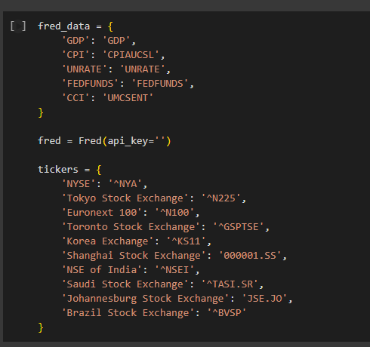
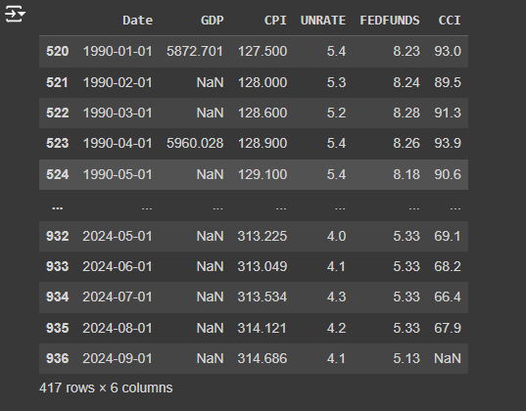
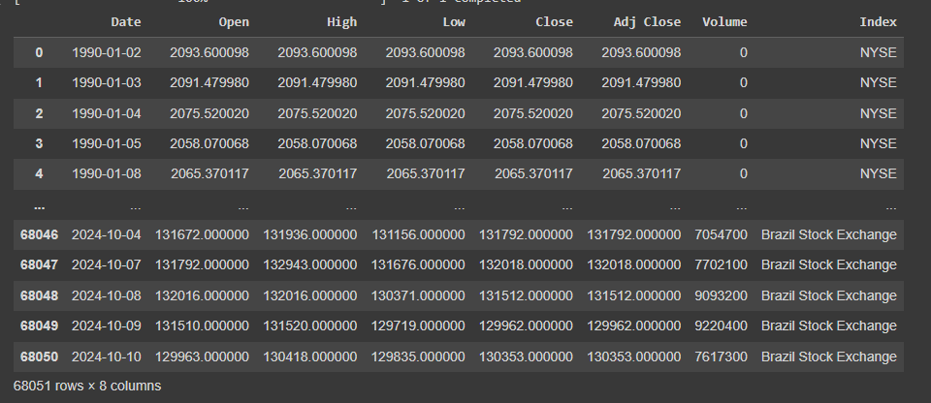
Data Retrieving
Data was retrieved from 2 APIs:
FRED (Federal Reserve Economic Data).
Yahoo Finance/Y-Finance
FRED Data (Monthly, Quarterly for GDP)
Yahoo Finance Price Data (Daily Data)

Slide 5
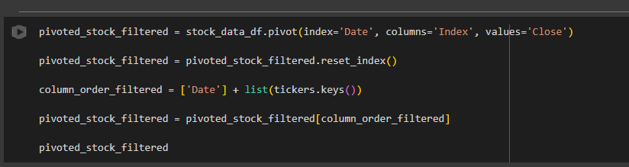

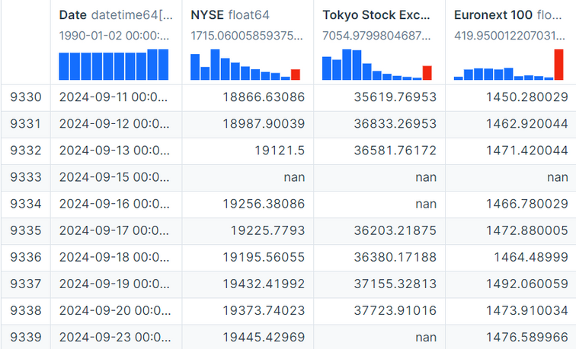

Data Cleaning
For each index, only “Close” prices are extracted.
Set the Name of the Exchange as Column Header.
Filling Missing Values with Forward Fill

Slide 6
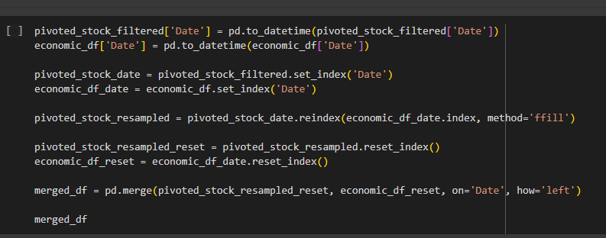
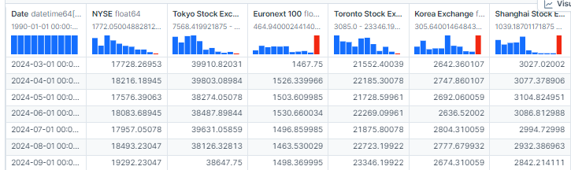
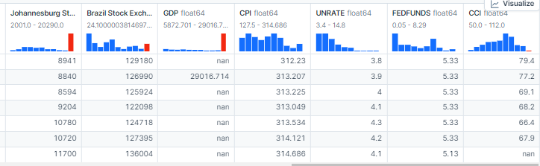
Merge the Data by Date

Slide 7
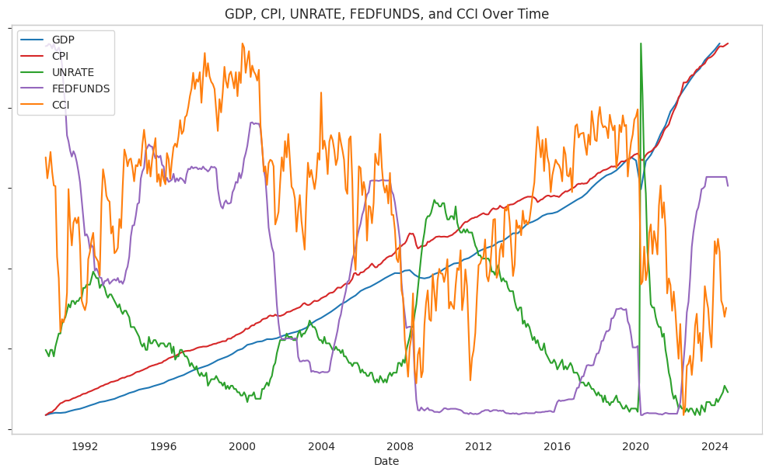
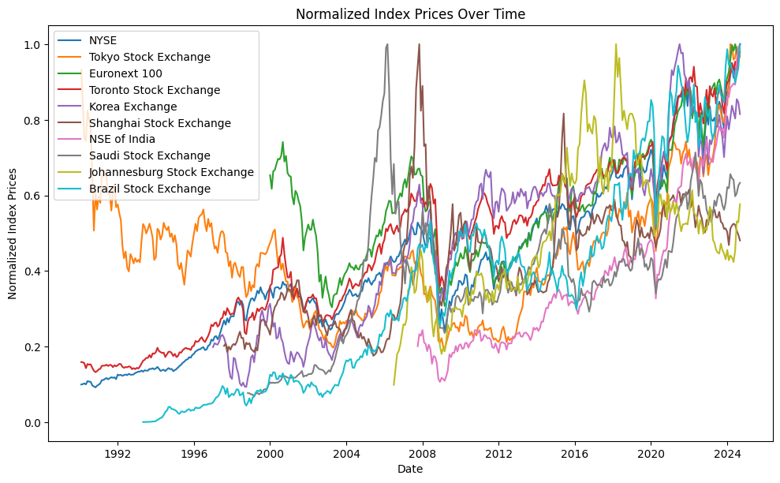
GDP, CPI, UNRATE, FEDFUNDS, and CCI & Stock Index Prices Over Time

Slide 8
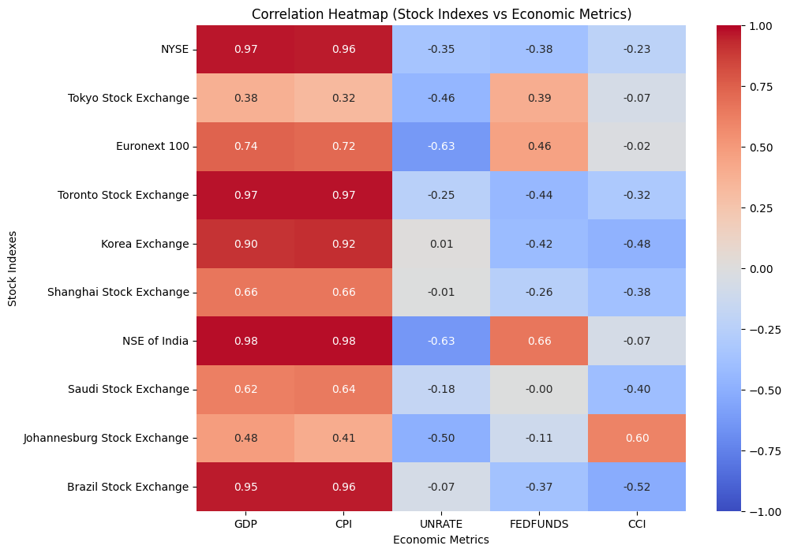
Regular Correlation
NYSE, Toronto Stock Exchange, and NSE of India have strong positive correlations with U.S. economic metrics like GDP and CPI, indicating these exchanges are more influenced by these factors.
In contrast, the Unemployment Rate (UNRATE) and Consumer Confidence Index (CCI) tend to have negative correlations with most stock indexes.
Notably, Tokyo Stock Exchange has weaker correlations across the board, while Johannesburg Stock Exchange and Saudi Stock Exchange display mixed correlations with U.S. economic metrics.

Slide 9
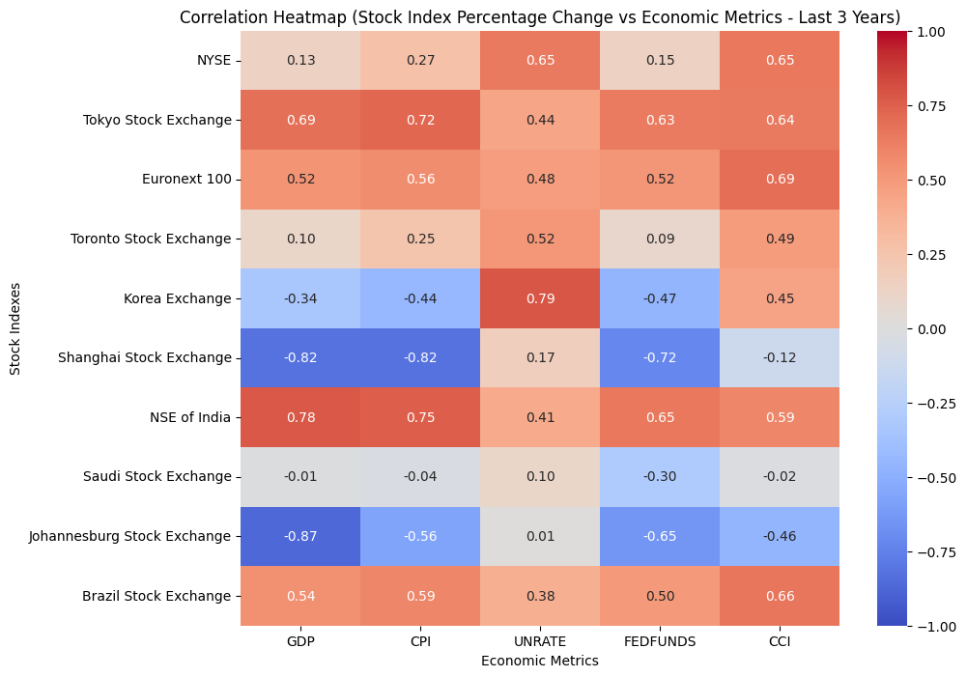
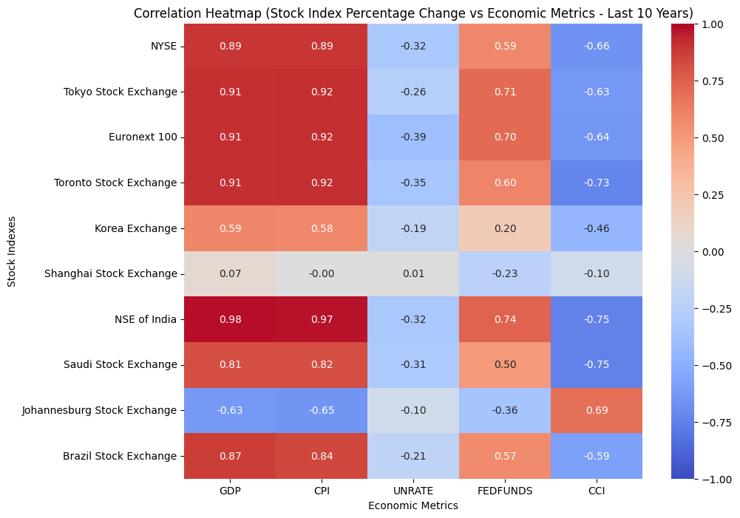
3 years
Period Correlation (3 Years & 10 Years)
01.
10 years

Slide 10
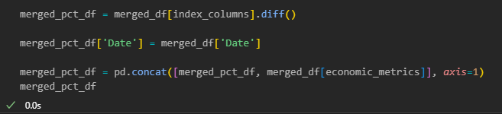
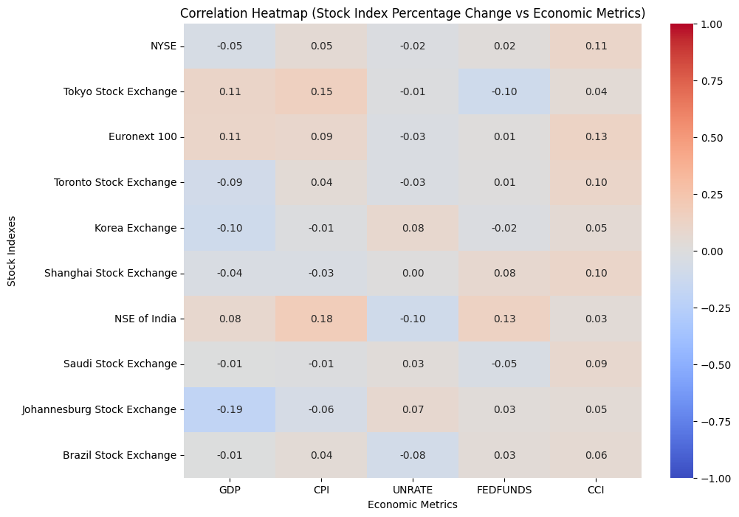
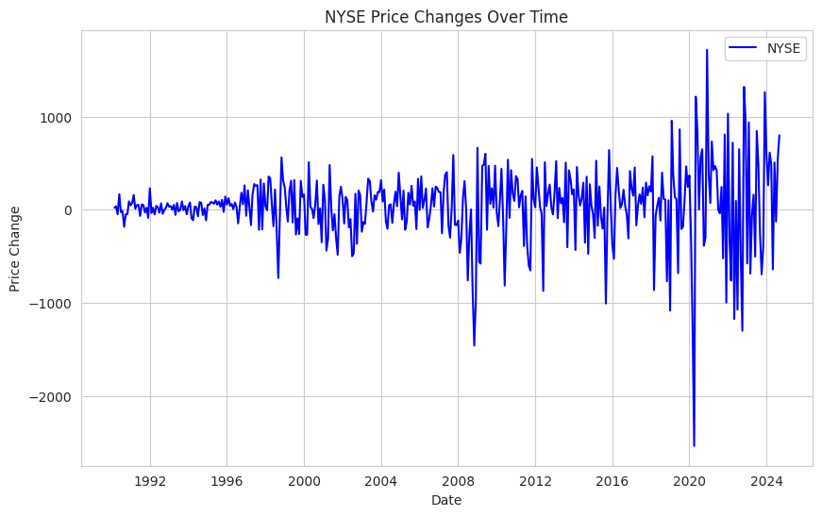
What if we flatten the price data?
10 years

Slide 11
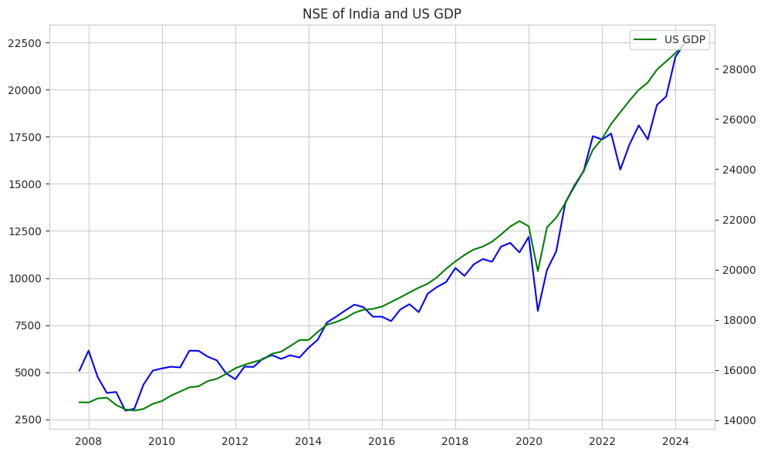
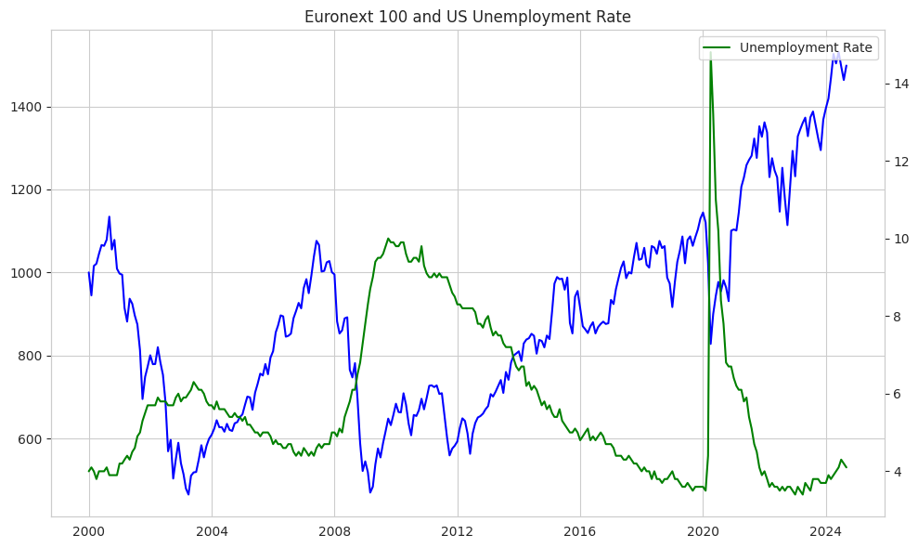
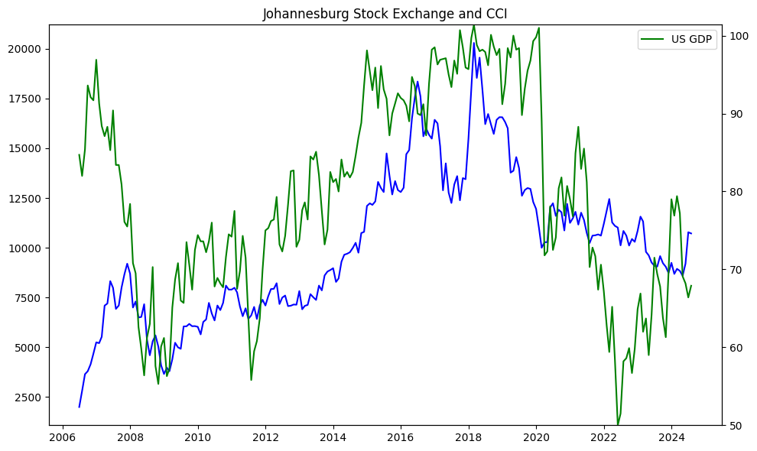
3 years
ρ: 0.98
ρ: -0.63
10 years
ρ: 0.66

Slide 12
Hypothesis I
Null Hypothesis (H0): The correlation or sensitivity of NYSE with the U.S. economic metrics is not stronger or the same with the International exchanges with the U.S Econometrics.
Alternative Hypothesis (H1): The NYSE (U.S Stock Exchange) have stronger correlation or more senstive with the U.S Economic metrics than the International exchanges with the U.S Economic metrics

Slide 13
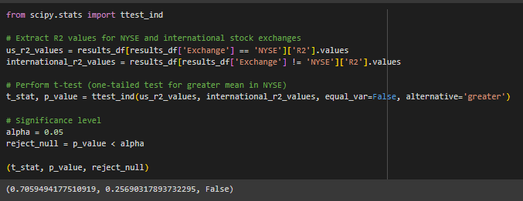
Hypothesis I
The t-test results show a t-statistic of approximately 0.705 and a p-value of approximately 0.256.
Since the p-value is greater than the significance level (alpha) of 0.05, we fail to reject the null hypothesis.
This means there is no statistically significant difference between the sensitivity of U.S. stock exchanges and international stock exchanges to U.S. economic metrics .

Slide 14
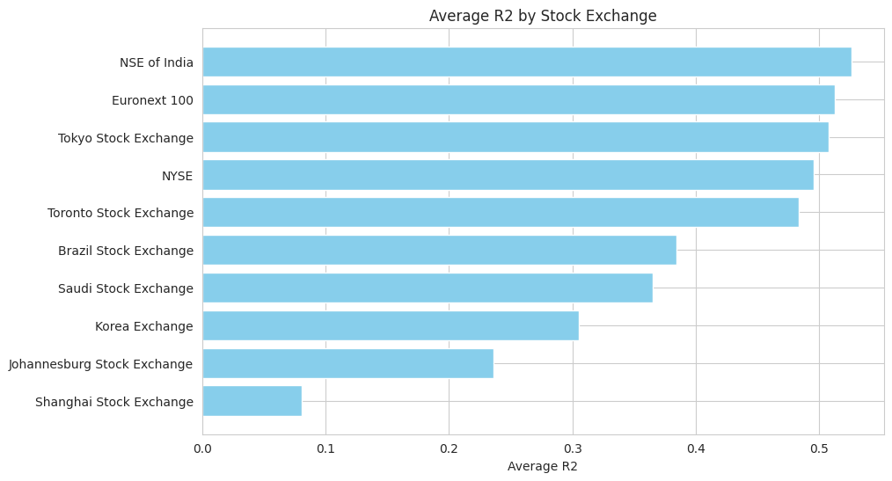
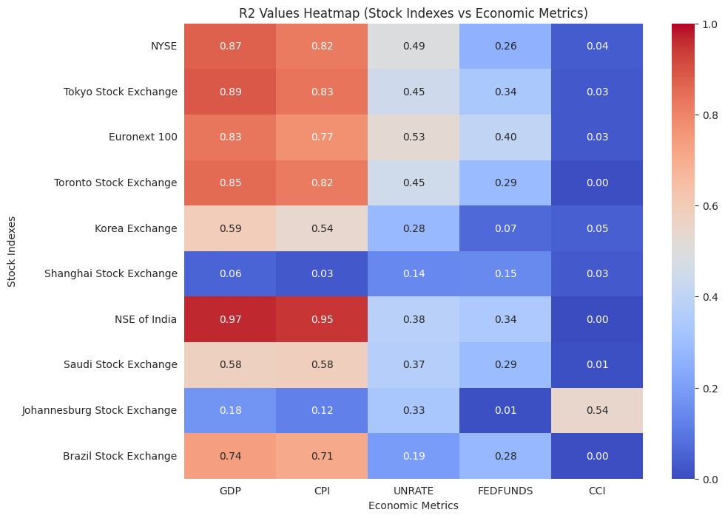
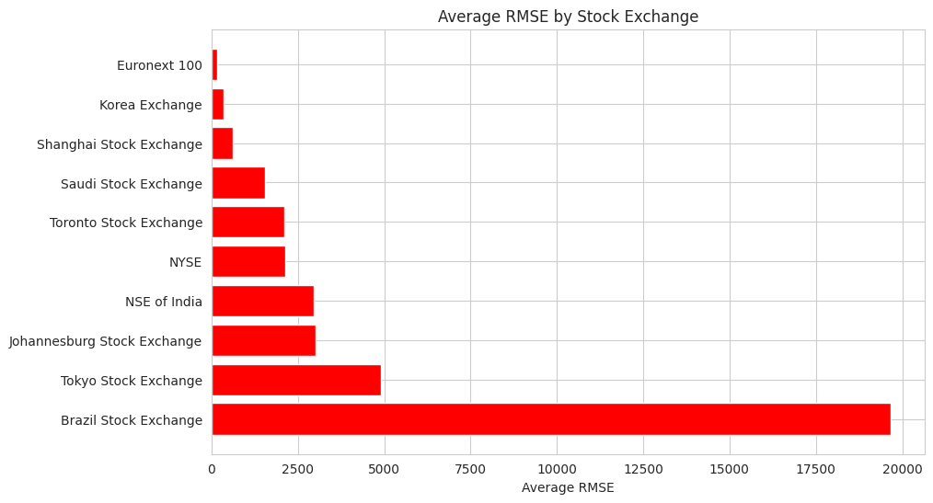
Hypothesis I

Slide 15
Hypothesis II
Null Hypothesis (H0): Stock exchanges in developed countries have no effect or non-significant correlation with U.S. economic metrics compared to those in developing countries.
Alternative Hypothesis (H1): Stock exchanges in developed countries show a stronger correlation or more sensitve with the U.S. economic metrics compared to those in developing countries

Slide 16
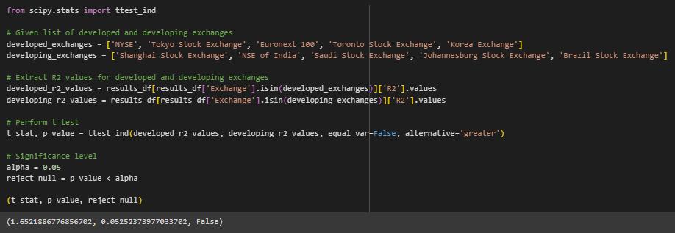
Hypothesis I I
The t-test results show a t-statistic of approximately 1.65 and a p-value of approximately 0.052.
Since the p-value is greater than the significance level (alpha) of 0.05, we fail to reject the null hypothesis.
This means there is no statistically significant difference that stock exchanges in developed countries show a stronger correlation with U.S. economic metrics compared to those in developing countries.
However, the p- value result is REALLY CLOSE to the alpha (0.052). If we make just a little bit change in the alpha, we can reject the null and conclude that THERE ARE STATISTICAL SIGNIFICANT DIFFERENCE between them

Slide 17
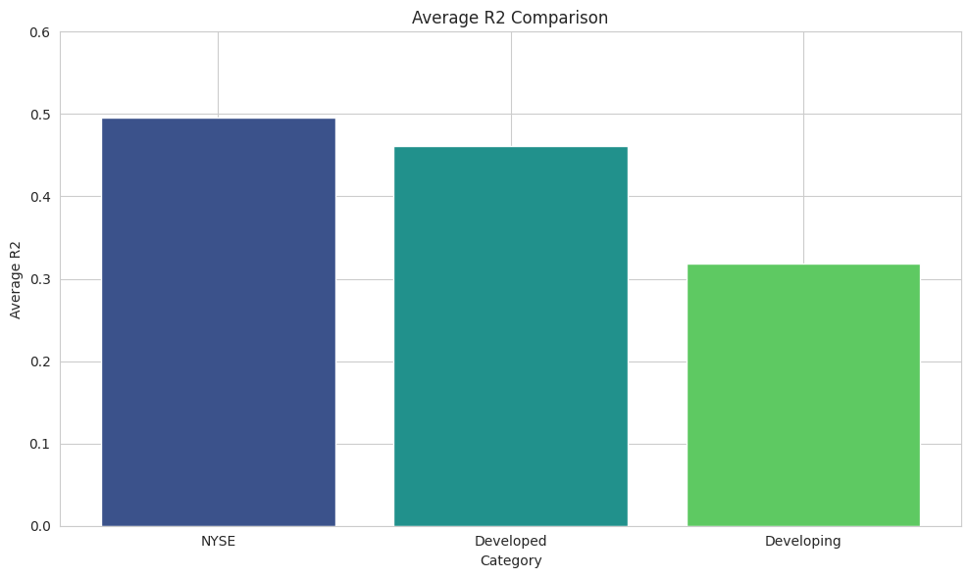
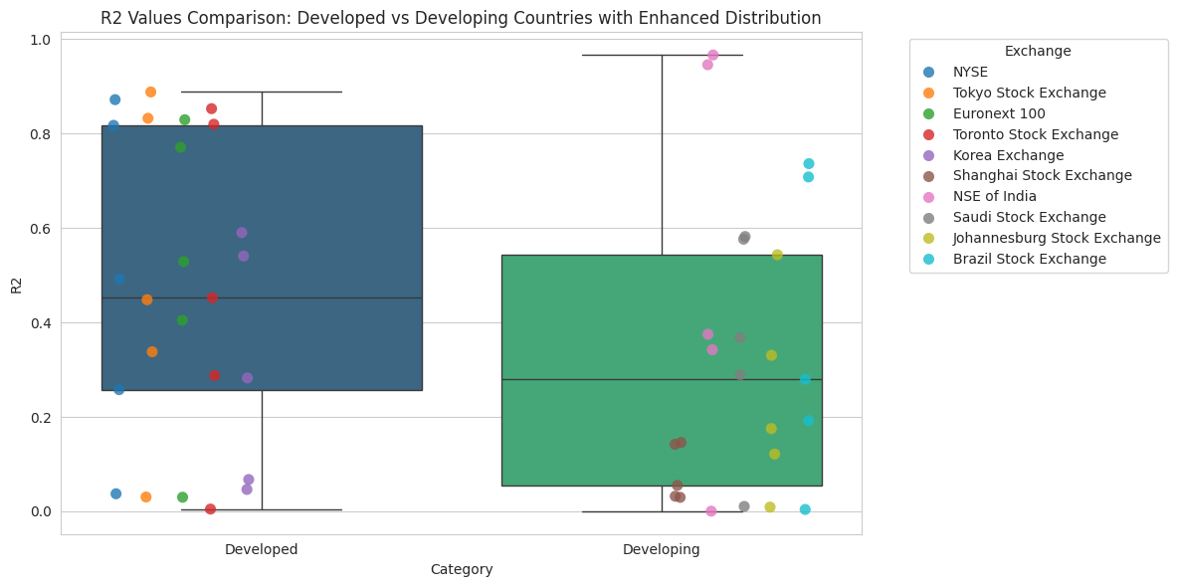
Hypothesis II

Slide 18
CONCLUSION
The analysis suggests that there is no significant difference in how the U.S. economic situation affects the stock exchanges' performances in the U.S. itself, developed countries, or developing countries.
This means we can invest anywhere we want, and the stock's performance will be roughly the same regardless of how the economic situation in the U.S. changes or progresses.

Slide 19
REFERENCES
Yahoo Finance. (n.d.). *Yahoo Finance*. Retrieved October 13, 2024, from https://finance.yahoo.com/
Federal Reserve Economic Data (FRED). (n.d.). *FRED API documentation*. Federal Reserve Bank of St. Louis. Retrieved October 13, 2024, from https://fred.stlouisfed.org/docs/api/fred/
Deepnote. (n.d.). *Deepnote*. Retrieved October 13, 2024, from https://deepnote.com/
OpenAI. (n.d.). *ChatGPT*. Retrieved October 13, 2024, from https://chatgpt.com/

Slide 20
Thank you very much!

